Slide 1
7th Meeting
WP 03 - Revision of the
LoD Concept
January 20th, 2015

Slide 2
Agenda (tentative)
Organisational Matters
  Next meeting
Definition of the geometrical aspects of the modified LoD concept – cont.

Slide 3
Where are, on what have we agreed
The label LoD4 should be replaced by Levels 0 – 3 for indoor objects
Semantical aspects: discussion postponed
Geometrical aspects: should be more precise

Slide 4
Where are, on what have we agreed
Geometrical aspects: first definitions
  LoD1:
    Building: Block, unique height?
    Room, BuildingFurniture: Block
  LoD2:
    Building: Block, with generalized standard roof type, roof overhangs (opt.), dormers/chimneys as generalized standard types (opt)
    Room: Block with prototypical ceiling and dormers structures
    BuildingFurniture: geometrical generalized geometry
    BuildingInstallation (dormers/chimneys): generalized standard types

Slide 5
Definition of LoD3: Proposals
CityGML 2.0 recommendation (Table):
  Absolute point accurracy 0,5m/0,5m (pos./height)
  Generalization: objects as real features, > 2*2m/1m
Biljecki et al. 2013:
  Minimal dimensions (e.f. footprint < 10m²)
  Geometrical complexity (e.g., no. of vertices)
  Positional accuracy (e.g., standard deviation)
Biljecki et al. 2014:
  ‘Feature complexity’: closeness to reality (e.g., minimum length of feature to be modelled)
Stadler & Kolbe 2007:
  Geometrical complexity: depth of nesting of geometry

Slide 6
Definition of LoD3: Proposals
Absolute point accuracy, maximal deviation of a point in the model from the reality, e.g., 0,5m/0,5m (pos./height)
  Relative accuracy? ISO 19113 ISO 19157
  Absolute accuracy relevant?
Minimal dimensions of a feature to be modeled

Slide 7
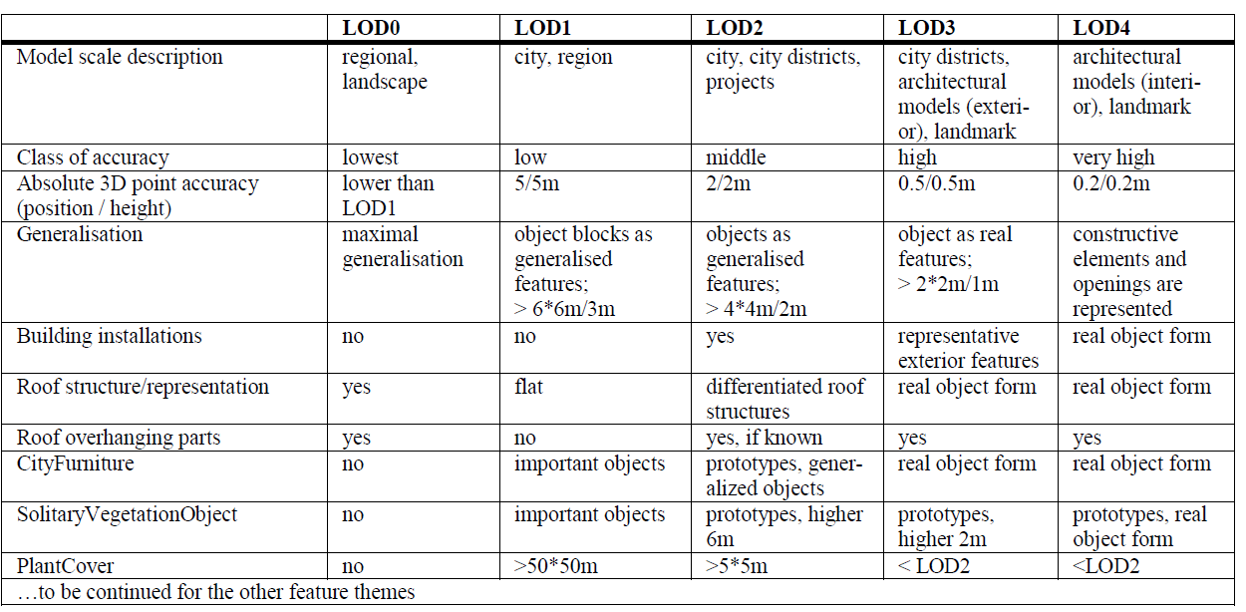
CityGML 2.0 recommendation

Slide 8
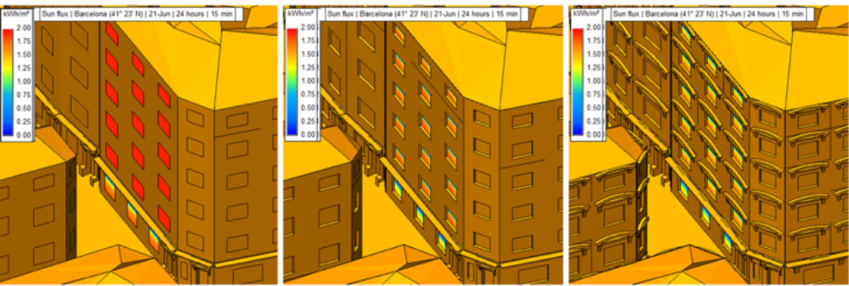
LoD3: 3 versions

Slide 9
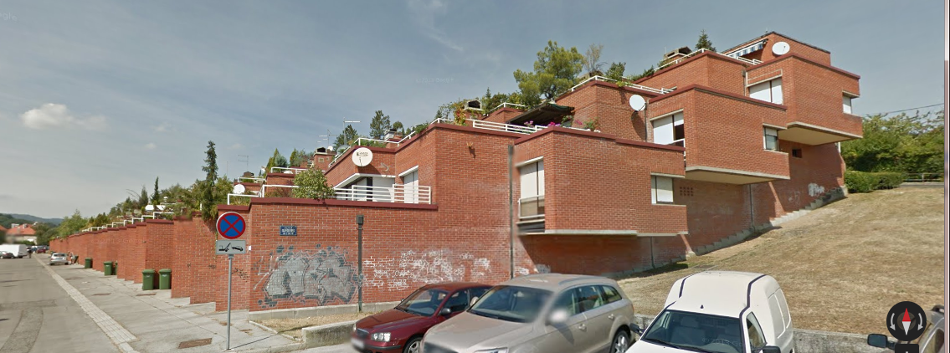
LoD1: unique height?

